Slide 1
Microservices Data Consistency Approaches: A tailored approach towards current limitations
PhD 3rd Progress
Asim Riaz
1732102
Supervisor:
Dr. Husnain Mansoor Ali

Slide 2
Contents
Problem Statement
Research Objectives
Research Roadmap
Basic Microservices Model
Adaptation Model
Transaction Manger
Pre Publish Event
Evaluation of Adaptation Model
Cross Microservice Validations
Feral Ordering
Implicit Cross Microservice Associations
Q&A

Slide 3
Problem Statement
Software industry heavily relies on custom data consistency implementations while using microservice architecture
Industry have multiple microservices data consistency approaches available at their disposal, however, their adaption is limited
This research will:
Pursue to identify the limitation of existing microservices data consistency approaches
Segregate the limitations that hinder the adaptation of microservices data consistency approaches by industry
Propose potential solutions to overcome selected limitations to increase industry adaptation of microservices data consistency approaches

Slide 4
Research Objectives
Evaluate limitations of microservices data consistency approaches for industry adaptation
Design and proposed adaptation model.
Testing and evaluation of proposed adaptation model.

Slide 5
Research Roadmap
Microservices
Data Consistency Approaches
Industry
Adaptations
of
Microservices
Implementation
Limitations of Adaptation
Adaptation Model
Sagas
Pros & Cons
2PC
Gaps
SEATA
Testing
Theoretical
Practical

Slide 6
Research Work Basic Microservices Model

Slide 7
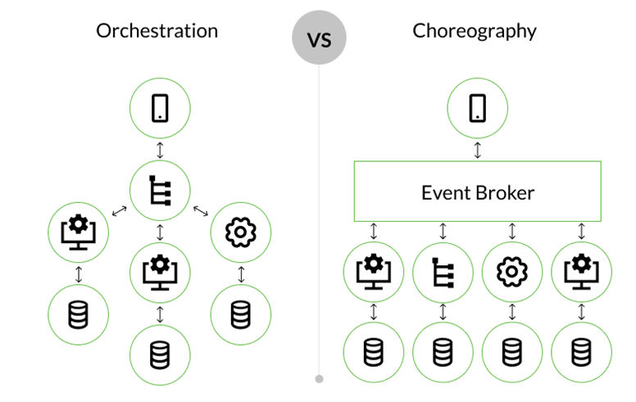
SAGA Pattern

Slide 8
Microservice Choreography
In order to assess the Adaptation model, it is imperative to establish an essential structure within which all transactions in a microservice environment can operate. To this end, a basic sales information system was selected as an exemplar for analyzing its various requirements.

Slide 9
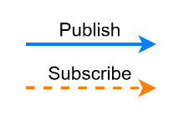
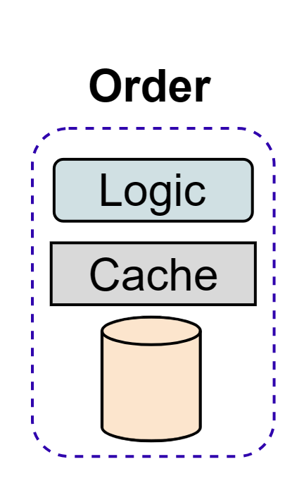
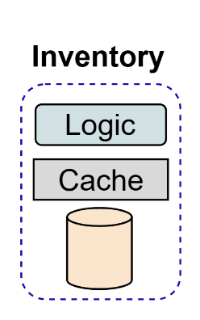

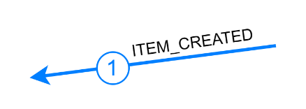
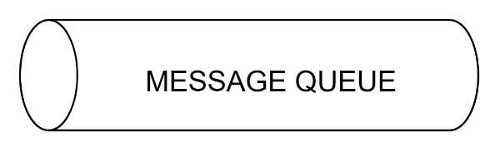
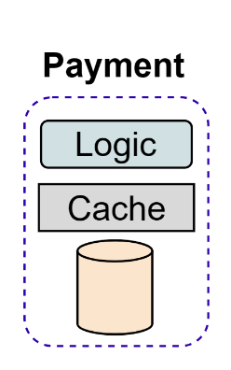

Basic Microservices Model

Slide 12
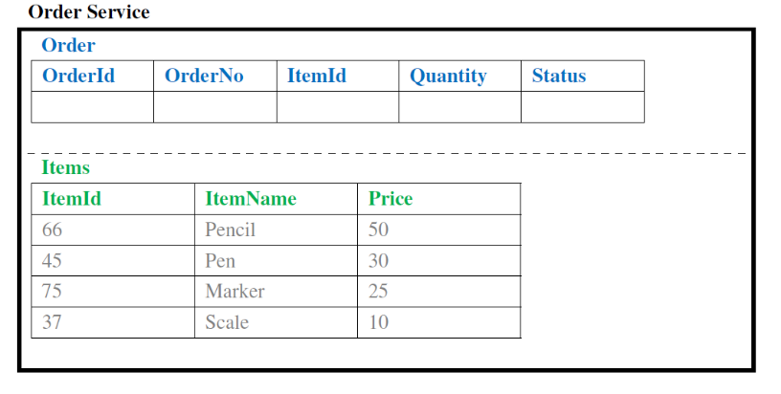

Slide 14
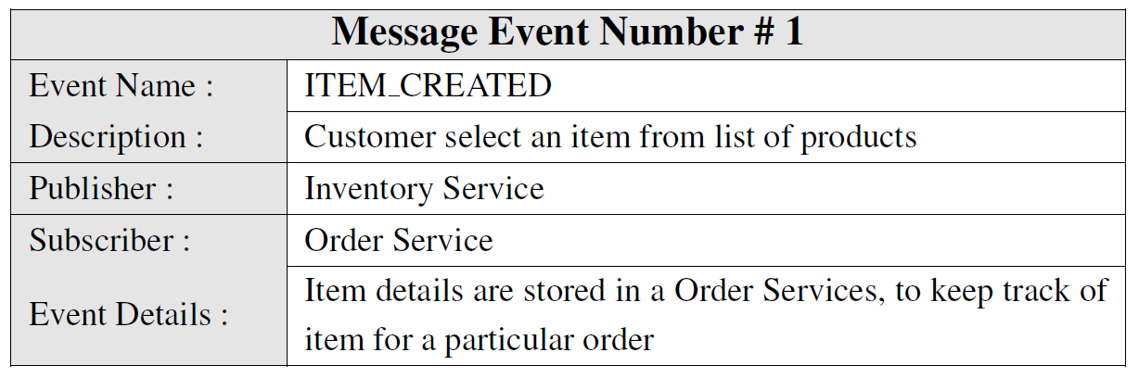
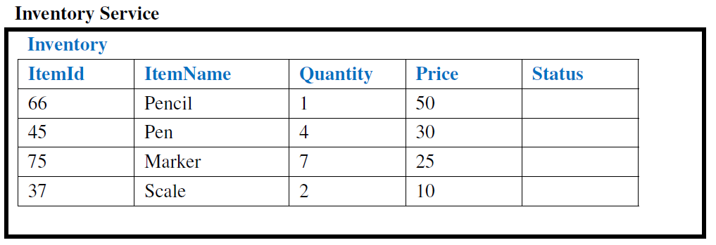

Slide 15

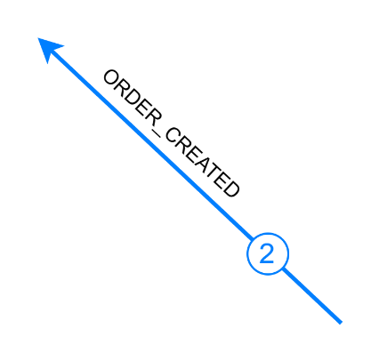
Basic Microservices Model

Slide 16
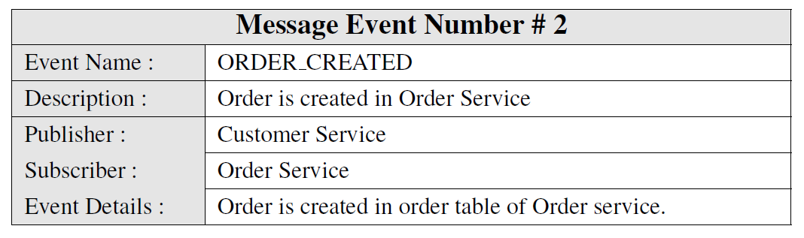
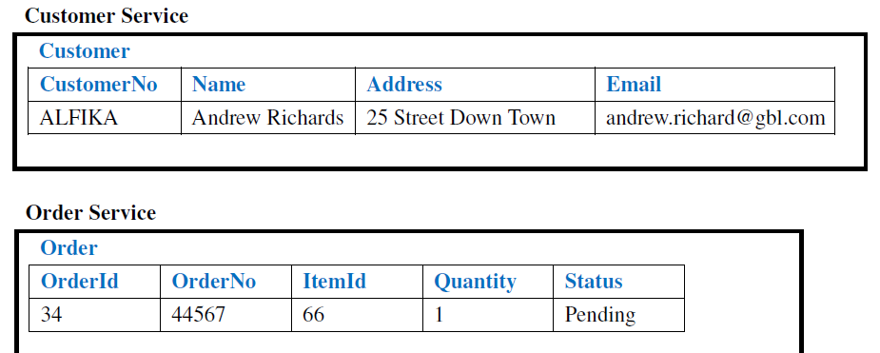

Slide 17
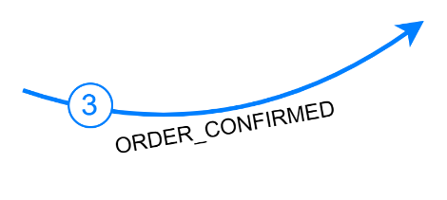
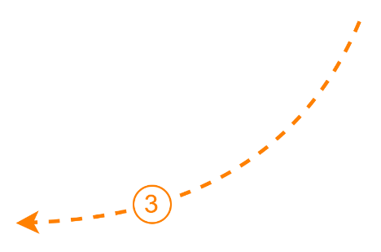
Basic Microservices Model

Slide 18
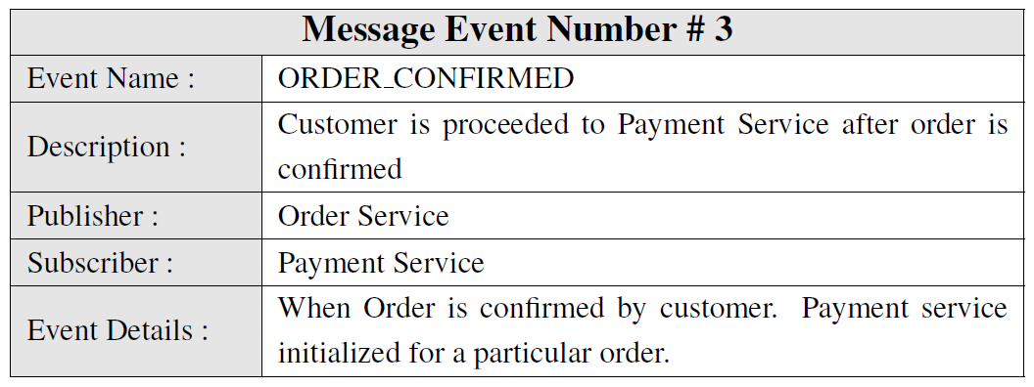
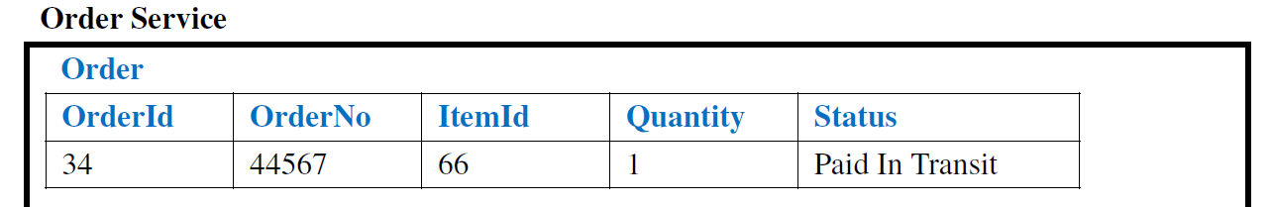
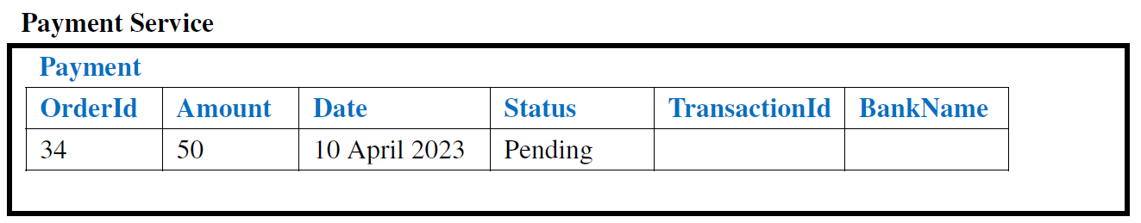

Slide 19

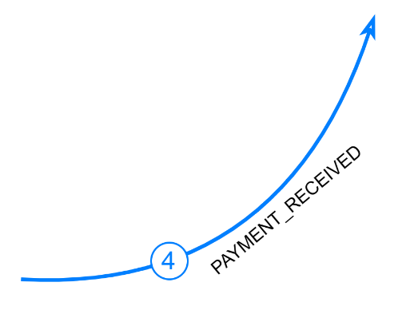
Basic Microservices Model

Slide 20
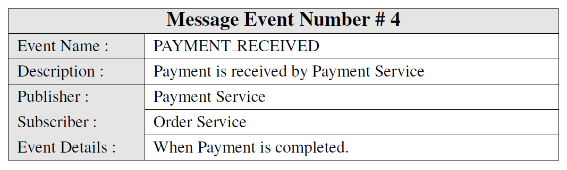
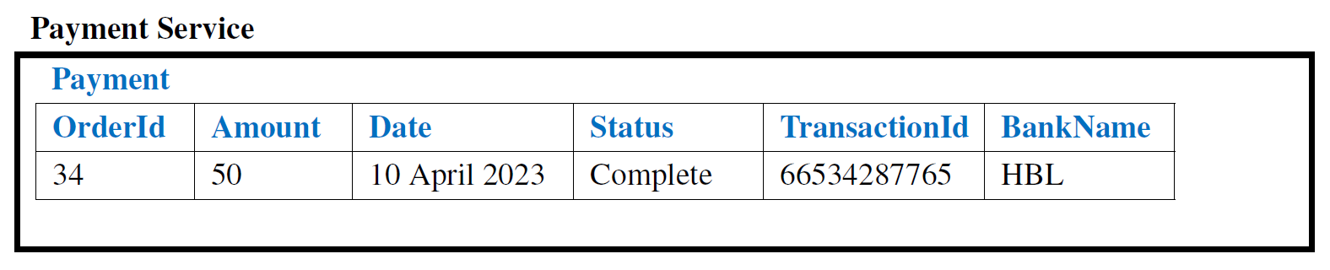
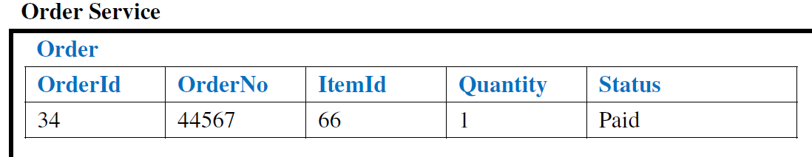

Slide 21
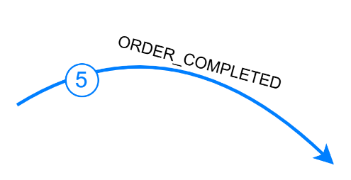

Basic Microservices Model

Slide 22
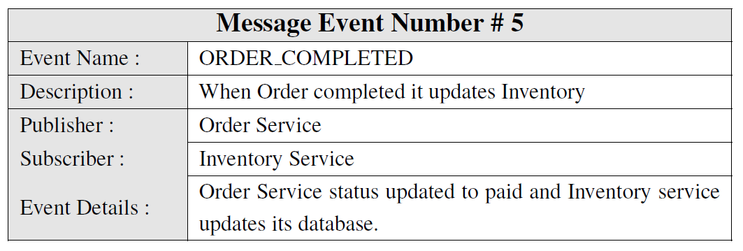
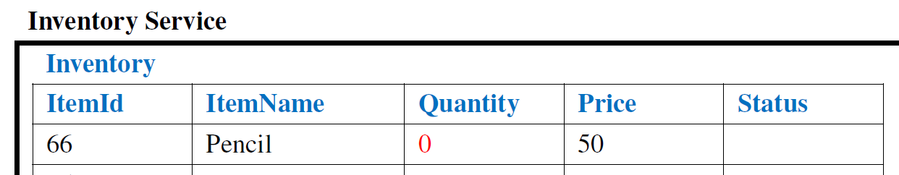

Slide 23
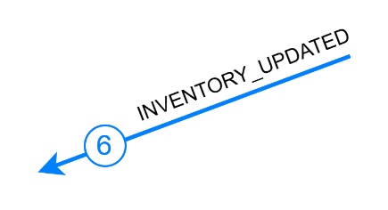

Basic Microservices Model

Slide 24
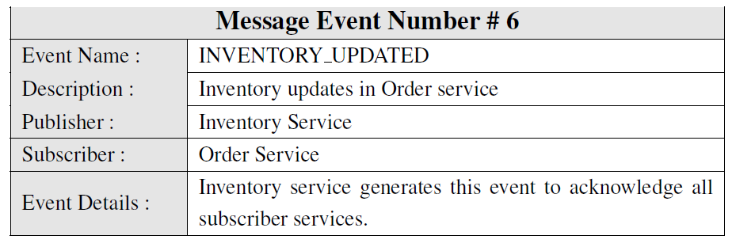
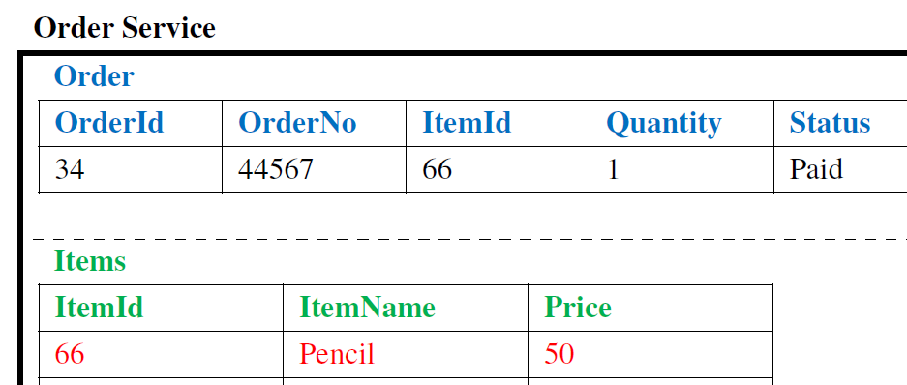

Slide 25
Research Work Evaluation of Adaptation Model

Slide 26
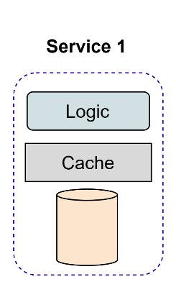




Adaptation Model
Adaptation Model
Transaction Manager

Slide 27
Transaction Manager
In order to facilitate pre-publish event some information must be included along with the payload of the message. Following information are as follows:
Transaction Number: This unique id is required to track a transaction in multiple message brokers.
Version Number: A transaction can update any data multiple times which can be track by similar truncation number with different versions.
Status: This information is use to handle the status of any transaction that is pending due to any reason. in Saga compensation semantic lock are used to mark a transaction as PENDING for a particular event. When that event occurs of pending transactions are rollback according to its execution sequence.
Payload: it contains all the data and type of operation required to the subscribed services.
Data: This includes any other data required to maintain any information about distributed transaction.
Post-Event Handler: it is required for developer to handle any such which is require to execute after message processing.

Slide 28
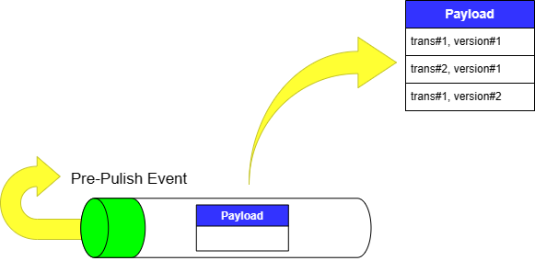
Pre-Publish Event

Slide 29
Research Work Adaptation Model Evaluation

Slide 30
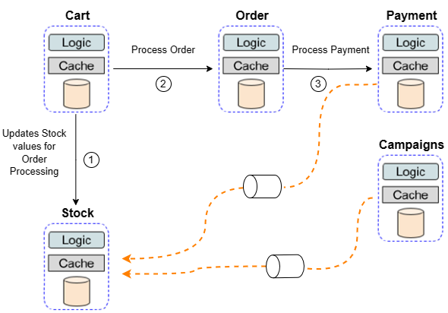
Cross Microservice Validations

Slide 31
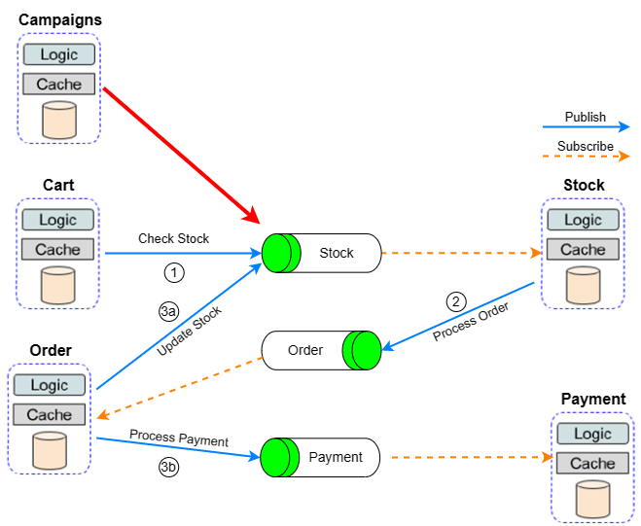
Adaptation Model: Cross Microservice Validations

Slide 32
Adaptation Model: Cross Microservice Validations Implementation

Slide 33
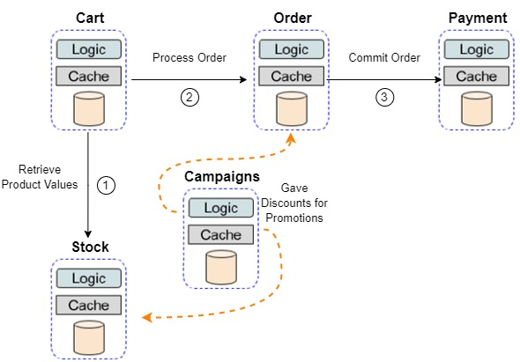
Feral Ordering

Slide 34
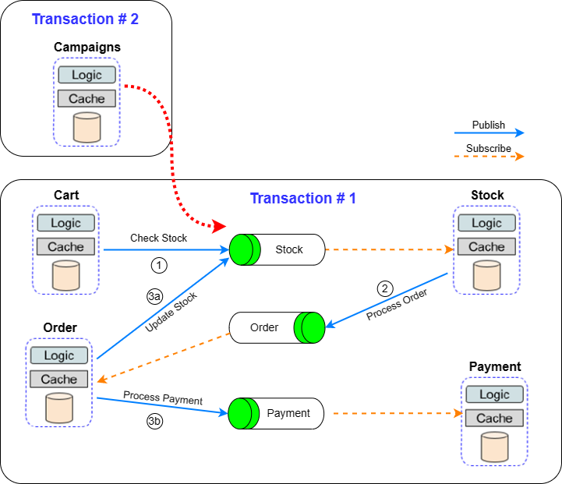
Adaptation Model: Feral Ordering

Slide 35
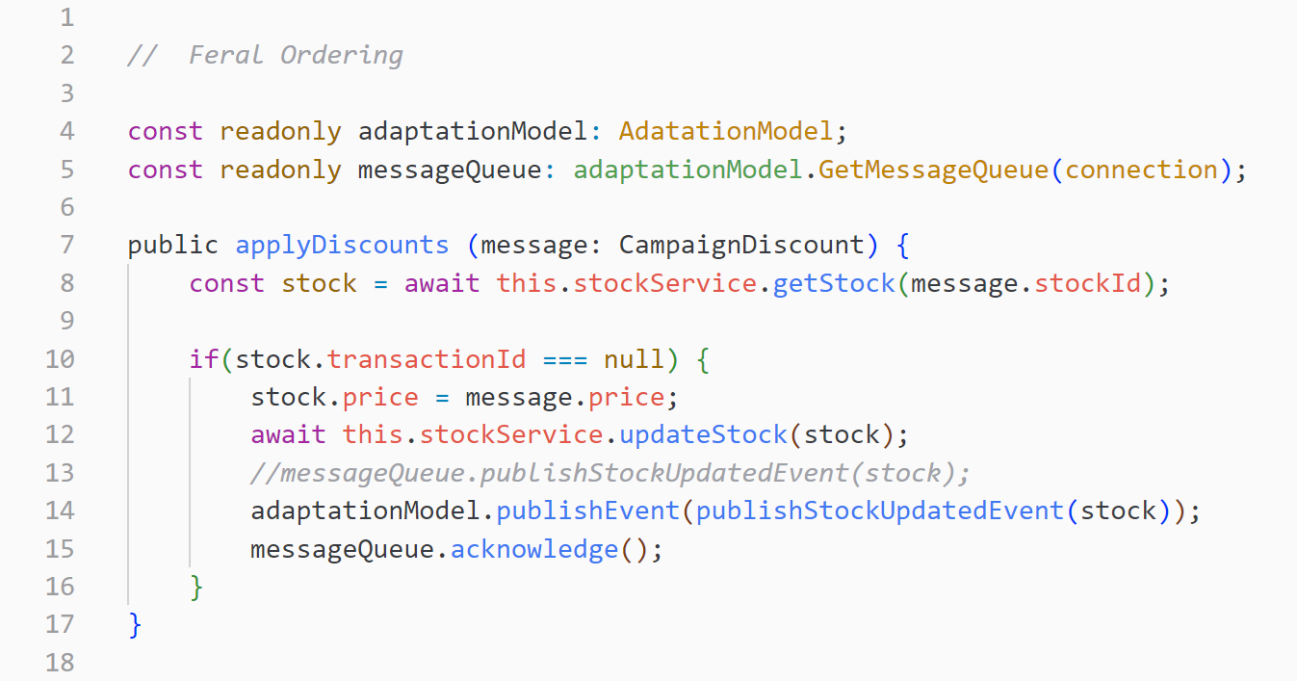
Adaptation Model: Feral Ordering Implementation

Slide 36
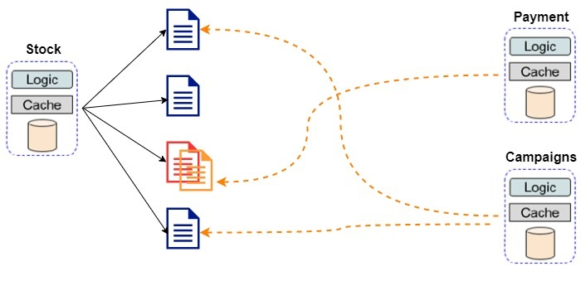
Implicit Cross Microservice Associations

Slide 37
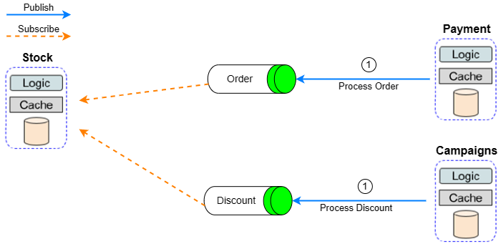
Adaptation Model: Implicit Cross Microservice Associations

Slide 38
Adaptation Model: Implicit Cross Microservice Associations
The choreography of microservices is capable of autonomously managing inter-microservice decisions, owing to the fact that the functional decomposition of microservices is inherently atomic in terms of its functionality.

Slide 39
Future Work
Parameters for Evaluating Data Consistency in Microservices Architecture
Dirty Reads
Lost Updates
Non-repeatable Reads

Slide 40
Question & Answer Session
Thank you

